Slide 1
“One club-One Community- One family.”

Slide 2
Overview
Club Profile Club Philosophy, Mission, Vision Programs Partnerships & Collaborations Coaches Parent/Player Communication Meet the Board

Slide 3
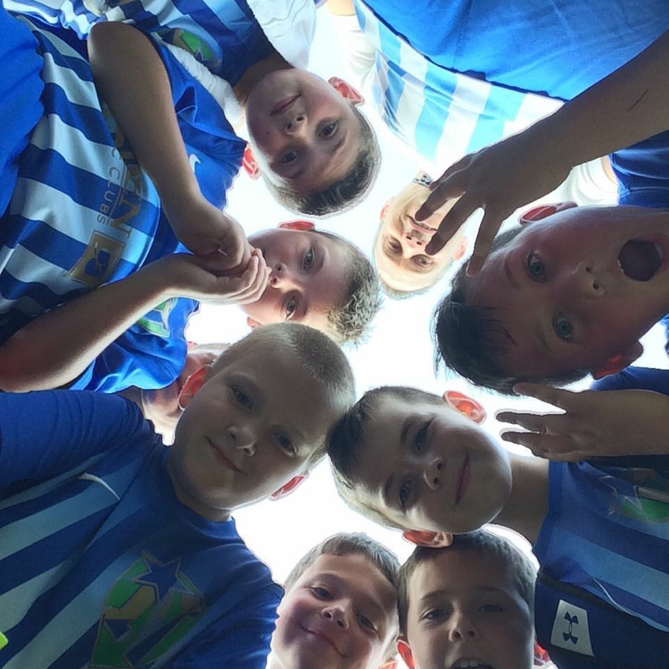
A look inside our organization…

Slide 4
Club Profile
Founded in 1995. One of the most tenured clubs in CNY 501(c)3 Non-for Profit Status Club serving mainly our school community Cicero-North Syracuse residents 13 competitive travel teams ages 2014 – 2008 (6) Lady Northstars teams, (6) Northstars Boys teams, (1) coed 2014 team 150 travel players 60 Introductory Skills Academy Program (5-12yr. Old) Participants 60 Mini Shooter Program (2-5yr. Old) Participants

Slide 5
Club Philosophy
It is our goal to develop young soccer players within our surrounding community. Our focus is on FUN and individual player development while learning the sport and competing at an appropriate competition level. U6-U14 Boys & Girls club teams are available for any players ready for competitive soccer. Through convenient scheduling, and various levels of opportunities this pool of players will continue to develop year-round. Professional coaching, abundant soccer opportunities, and a sense of community makes this team perfect for any serious young soccer player.

Slide 6
Coaching Philosophy
The Northstars Soccer Club will provide a competitive & stable environment required for all players to achieve and realize not only individual goals but also team success and accomplishments. Discipline & high work rates will be the framework around all players: mental, physical, technical, tactical, & team developmental training. Our teams are young so coaches are reminded that results are not top priority. Players who are not ready for competitive play, are encouraged to train with the team and enroll in our Skills Academy once-a-week program to get fundamentals up to par.

Slide 7
Mission Statement
The Northstars Soccer Club provides competitive, challenging, & dynamic training with a consistent coaching philosophy. Northstars Soccer Club prides itself on providing the best coaching, fields, facilities, training equipment, and extra opportunities to our players. We are committed to being best and most recognized youth soccer program in our local community. (Towns of Cicero, North Syracuse, Mattydale, Clay, Liverpool)

Slide 8
Vision Statement
Continue to be the best show in town! The Northstars Soccer Club aspires to provide a quality, low cost, year-round program for players of all ages in our community to benefit from & enjoy! We want to be viewed as the best, and only club choice fit for youth in our local community.
One Community- One Club- One Family!

Slide 9
Club Goals & Objectives
Offer a high quality, low cost soccer program for all players in our community. Build friendships & team chemistry from a young age Have FUN!! Help players develop a passion for the sport. Teach & develop advanced technique Provide serious young soccer players with an effective support structure to facilitate their development Improve tactical awareness in individual and collective attacking & defending Physical training Our preparation to play soccer involves aerobic, anaerobic, & plyometric conditioning. Tactical training. We will teach players to learn the game from all positions (parts of the field) from a young age. And help them choose a position that suits them as thy get older. Technical Training: Without technique there is no tactics! Focus on ball skills, dribbling, passing, shooting, shielding, tackling, heading, communication.

Slide 10
Core Values
Family- We pride ourselves on our sense of togetherness and unity. Between boys & girls teams as equals. Using activities offered by the club on and off the field will strengthen the bonds between our athletes and those who care for them. Sportsmanship- show proper respect toward teammates, opponents, coaches, officials, and spectators. There is grace in not only winning, but also losing. There is zero tolerance for negative behavior and engaging in conflict. We rise above this behavior and choose to be a positive reflection of our team, club, and community. Teamwork- Support, encourage your teammates. We put the success of the team before any personal stats. Competitiveness- We seek to win at all times, though not at all costs. We will teach our players persistence, hard work, and a positive attitude. It is our responsibility to ensure that our competitiveness does not ever standi n the way of our other core values and teach our youth how to be competitive and still reflect sportsmanship, teamwork, all while not forgetting to have fun. Coaches challenge every player to be better. Players be mentally & physically ready to play your hardest to make each other better every time you step on the pitch. Fun-Smile and enjoy this beautiful sport every practice, every game. Excellence- We have high standards and hold ourselves accountable for these standards.
Notes:
Who we are. What we do.

Slide 11
Young Blood
Our club is very young. Our oldest team is 2008 U13. Our feeder system is working with a team at every age U7 and older for boys & girls. Our staff believes in the motto “Without technique there is no tactics! We focus on technical coerver ball skills, dribbling, passing, shooting, shielding, tackling, heading, communication.”
Raise the Bar- On the ball confidence, composure, decision making. We want our players to not only be comfortable with the ball at their feet…. But we want them to want the ball!

Slide 12
Pick what fits. Square peg in a round hole.
Our coaches understand its vital to seek out appropriate leagues/ tournaments. Each team in our club is at a different ability level. Some are more elite teams. Some are average. And some are newer and less developed as a core group of players. This is okay and our coaches will seek out the proper level of competition for each of their teams. We want all of our teams to be successful and challenged properly.

Slide 13
Collaborate
Our club has a good reputation with the local soccer community. We often collaborate with other local clubs, coaches, groups to set up friendly scrimmages to supplement our league play.
Our club offers camps, clinics, programs through the Town of Clay- Recreation Dept. to expand our scope and base.
Our Directors seek out memorable opportunities with local colleges, and semi pro teams for our kids to enjoy!
We have grown our clubs tournament over the years by partnering with local colleges.

Slide 14
Cornerstone
Coaching Staff: Program Director, Director of Boys Northstars: Todd Cook UUSSF National C-License, Director of Men’s Soccer Operations- Syracuse University (2015- 2019), Skaneateles Girls Varsity Soccer Coach (2012-2014), Liberty League Coach of the Year 2012 & 2013, Le Moyne College Men’s Soccer Player (1998-2001) Director of Lady Northstars, Mini Shooters Director: Paul Palucci USSF E-License, SUNY Oswego Soccer Player (2002-05), SUNY Oswego All-Tournament Team 2002, SUNYAC Soccer All Conference Team 2003 Our staff is made up of professionals whom are qualified from former playing experience and have a vested interest. All coaches in our club have a child or grandchild in the program. This makes them reliable, punctual, eager to teach. (Sergio Palucci, All American LeMoyne College, Jon Pollard Liverpool JV Soccer Coach, Allan Schroeder Bryant & Stratton Soccer Asst. Coach, Jeff Asscenzo Former CBA Sectional Soccer Champion, Mike Peplinski Liverpool All American Soccer Player/ WVU, Noelle Raymond UIMASS Lax Player, Stephanie Reeve UMASS Soccer Player, Andrea Mackey St. John Fisher Softball, Danielle Brough Middle Tenn. St. Soccer Player, Heather Marzullo Former Goalie All American)

Slide 15
Reach for the Stars
Our club administers an annual parent survey. This opens the communication channel providing honest feedback for directors, coaches, managers to address and improve upon.
Our staff has all been cleared to coach through mandatory online courses. Our staff is committed to professional development. Our coaches are all licensed through US Youth Soccer and are looking to take more courses offered locally.
We have parents sign a Parent/Player Code of Conduct. The youthfulness of our club aged teams provides a perfect way to train the players & parents in proper/acceptable on the field and off the field (sideline conduct).

Slide 16
Club Highlights
U11 Futsal Frenzy Champions 2020 U11 CNYFSC Ileague Champions 2020 U10 CNYFSC Playoff Champions 2020 U10 May Day Finalist 2019 U11 Lakefront Classic Finalist 2019 U12 NPSL Runner-up 2018 U9 & U10 Salt City Champions 2018 U9 Accelerate Sports Holiday Champions 2017 U10 Accelerate Sports Holiday Finalist 2017 U9 Hershey, PA Finalist 2017 U9 Saratoga May Day Champions 2017 U11 Saratoga May Day Finalist 2017 U8 Northstars Cup Finalist 2017 U10 Northstars Cup Champions 2017 U9 Hershey, PA Finalist 2016 U7 Northstars Cup Champions 2016 U9 Indoor League Champions 2015 U9 XMAS Tournament Champions 2015 U9 Thanksgiving Tournament Champions 2015 U9 Brockport Tournament Champions U8 CNYFSC XMAS Tourney Champs 2014 U8 Northstars Cup Finalist 2014 U-14 Niagara Pioneer Champions 2012 U-14 Saratoga May Day Champions 2011 U-12 Salt City Champions 2010 U-12 Brockport Champions 2010 U-10 2009 CNYFSC Holiday Tourney Champs U-14 & 19 2009 CNYJSA League Champs U-13 & U-14 2009 May Day Champions U-13 2009 Gates Invitational Champions
20 Years of Excellence!!
U-9, 11, 14 2009 Hilton Parma Champs U-13 2009 Gates Invitational Champions U-9, 11, 14 2009 Hilton Parma Champs U-10 & 11 2009 CNYFSC Thanksgiving Champs U-17 Northstars Cup Champions 2008
U-15 WSA Tourney Runner Up 2008 U-14 May Day Champions 2008 U-13 CNYJSA League Champions 2008 U-12 Hilton Parma Champions 2008 U-11 Hilton Parma Champions 2008 U-11 Gates Champions 2008
U-13 CNYJSA League Champions 2007 U-17 Webster Invitational Runner-up 2006 U-14 CNYJSA League Champions 2006 U-14 Greece Cobra Runner-up 2006
U-14 Webster Runner Up 2007 U-13 Gates Champion 2007 U-13 Chili Champion 2007 U-12 CNYJSA League Champions 2007 U-14 Brockport Runner-up 2006
U-12 Marcellus Tournament Champions 2006 U-12 Camden Tournament Champions 2006 U-14, 17 Indoor Playoff & League Champions 2006 U-13 Boys Salt City Champions 2005
U-12 Boys Vestal Tournament Champions 2005 U-13 Long Island Tournament Champions 2011

Slide 17
Club Programs
Our club offers programs to the public. These programs are advertised through the Town of Clay Recreation Department. These programs serve as the front lines (first impression) to what our club has to offer. These 3 programs serve as a feeder system into our competitive travel club. This is where we teach the fundamentals, in a FUN introductory no pressure environment.
Club
Camp (5-14 yrs.)
Academy (5-12 yrs.)
Mini Shooters (2-5 yrs.)

Slide 18
Annual Tournament Offerings
Our club offers two tournaments throughout the year. These provide not only our teams additional competitive benchmark opportunities. But has also become an enjoyable event for other clubs in the CNY, WNY, & ENY.

Slide 19
Seasonal Team Tryout & Fee Structure
Players will be grouped by age and ability level to maximize player development. Club policy is to have players placed age appropriately. All teams will hold tryouts semi-annually creating the strongest possible team that can be fielded in each age group. Teams will compete year-round with a united sense of club/ team spirit.
Any interested male players should contact Todd Cook, Director of Boys so he can get you team specific information. tcook2@nscsd.org Any interested female players should contact Paul Palucci, Director of Girls Program so he can get you team specific information ladynorthstars@gmail.com
All of our teams have open tryouts at any time during the year. Just make an appointment to attend one of our practices to see how your child likes it. And allow that particular teams coach assess how your child fits the teams level of play.
((Sept 1st – October 21st) Fall Fee= $150 (includes weekly league & practice)
(October 25- April 5th) Winter Indoor Fee= $550 (includes weekly league & practices)
(April 10th- July 30th) Spring/Summer Outdoor Fee=$550 (includes weekly league & practice & full uniform & 3 tournaments)

Slide 20
Sponsors
Our club sponsors are our partners! We see a return, if they see a return.
I.e. Chick-fil-A night, Uniform Pickup at Allstate Insurance Office, Driveway Sealing club pricing coupons

Slide 21
Meet the Board
Board of Directors: President: Don Cook joeysbrokerage@verizon.net (1995 – Present)
Treasurer: Mike Cackett (2002-Present)
Registrar: Mark Petranchuk. mpetranchu@aol.com (2002-Present) (Grandchild in program and sons played in club) Program Director: Todd Cook. tcook2@nscsd.org (2002-Present)

Slide 22
Find us online
www.northstarssoccerclub..com
Facebook @NorthstarsSoccerClub
Facebook @NorthstarsCup

